Slide 1

Women in Politics & Political Violence Targeted Women
By
San Thet Nwe
Wut Yee Phyo
Khine Zar Lwin
Nu Wai Thet
Nuam Man Cing(Mentor)
Myat Wit Yi(Mentor)

Slide 2

Contents
Objectives
Introduction
Women Representative in Parliament Analysis
Political Violence Targeted Women Analysis
Statistical Approach & Model Selection
Statistical Analysis
Key findings and Insights
Conclusion

Slide 3
Introduction
This project seeks to analyze women's involvement in politics and the prevalence of violence or attacks targeting women in political roles.
By studying trends, patterns, and underlying factors, the project aims to provide insights into the challenges faced by women in politics, highlight areas requiring intervention, and support data-driven advocacy for gender equity in political spaces.

Slide 4
Objectives
To assess the level of women's participation and representation in political positions
To investigate trends and incidents of violence or attacks targeting women in political roles
To explore the underlying causes that lead to gender-based violence in politics
To find out whether targeted violence against women can affect women’s place in politics
To provide practical recommendations to promote gender equity and improve the safety of women in political roles

Slide 5
Data Collection
This research utilizes two datasets: the Women in Parliament (WIP) dataset and the Political Violence Targeting Women (PVTW) dataset.
While the WIP dataset provides insights into women's political representation, the PVTW dataset extends the analysis beyond formal political institutions to examine politically motivated violence against women in public spaces.
By combining these two datasets, this study offers a comprehensive understanding of both women's participation in politics and the broader threats they face - not only as politicians but also, as activists, protesters, and members of the general public.

Slide 6
Data Source Acquisition
Parliamentary Data (IPU): Public datasets on Members of Parliament (MPs) from different countries, including gender representation and political roles.
We have analyzed the IPU data based on the following factors;
Global and regional average of women
Monthly women ranking, women’s seats in all chambers
Structure of Parliament and Political System
Gender Quota and others related facts
Notes: IPU can refer to the Inter-Parliamentary Union , an international organization of national parliaments. IPU facilitates parliamentary diplomacy and empowers parliaments and parliamentarians to promote peace, democracy and sustainable development around the world.

Slide 7
Data Source Acquisition
PVTW dataset: Public datasets on violence against women in politics from ACLED. PVTW is a subset of all violence targeting civilians.
We have analyzed the PVTW data based on the following attributes;
event_date, year
event_type, sub_event_type
actor, interaction
region, country
fatalities
notes….
Notes: Armed Conflict Location & Event Data (ACLED) is a disaggregated data collection, analysis, and crisis mapping initiative. ACLED collects information on the dates, actors, locations, fatalities, and types of all reported political violence and protest events around the world. The ACLED team conducts analysis to describe and explore conflict trends.

Slide 8
IPU Data Analysis

Slide 9
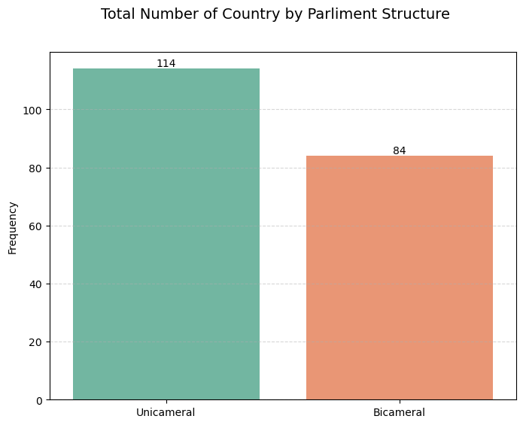
Structure of Parliament and Political System
 | America Region | Asia Region | Europe Region | Middle East and North Africa Region | Sub-Saharan Africa Region | Pacific Region
Communist system | 1 | 4 | - | - | - | -
Monarchy | - | 2 | - | 7 | 1 | 1
Parliamentary system | 12 | 9 | 37 | 2 | 7 | 9
Presidential system | 21 | 7 | 1 | - | 14 | 3
Presidential-Parliamentary | 1 | 5 | 10 | 5 | 19 | 1
Transitional system | - | 2 | - | 4 | 6 | -

Slide 10
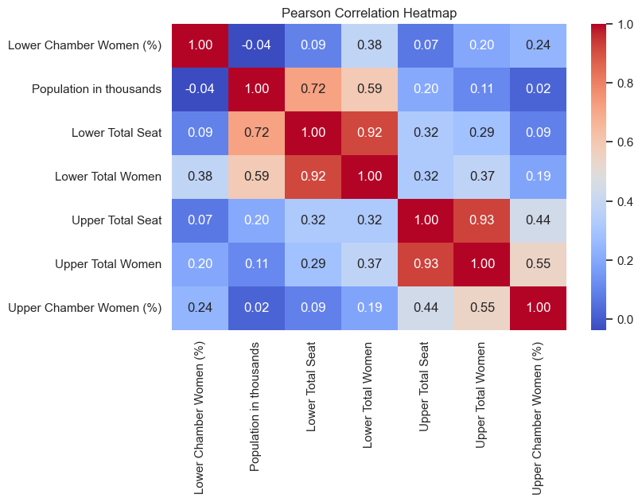

Do numerical features,
such as population size
and total seats,
significantly impact women's representation in parliament?

Slide 11
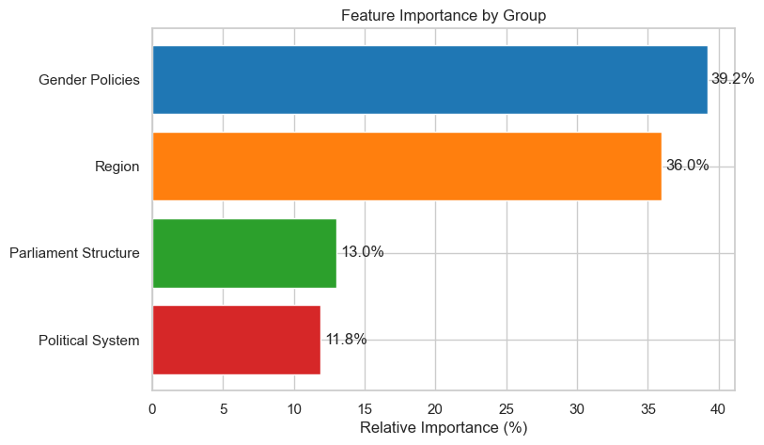
Which categorical features have the most impact on
women's representation
in parliament?

Slide 12
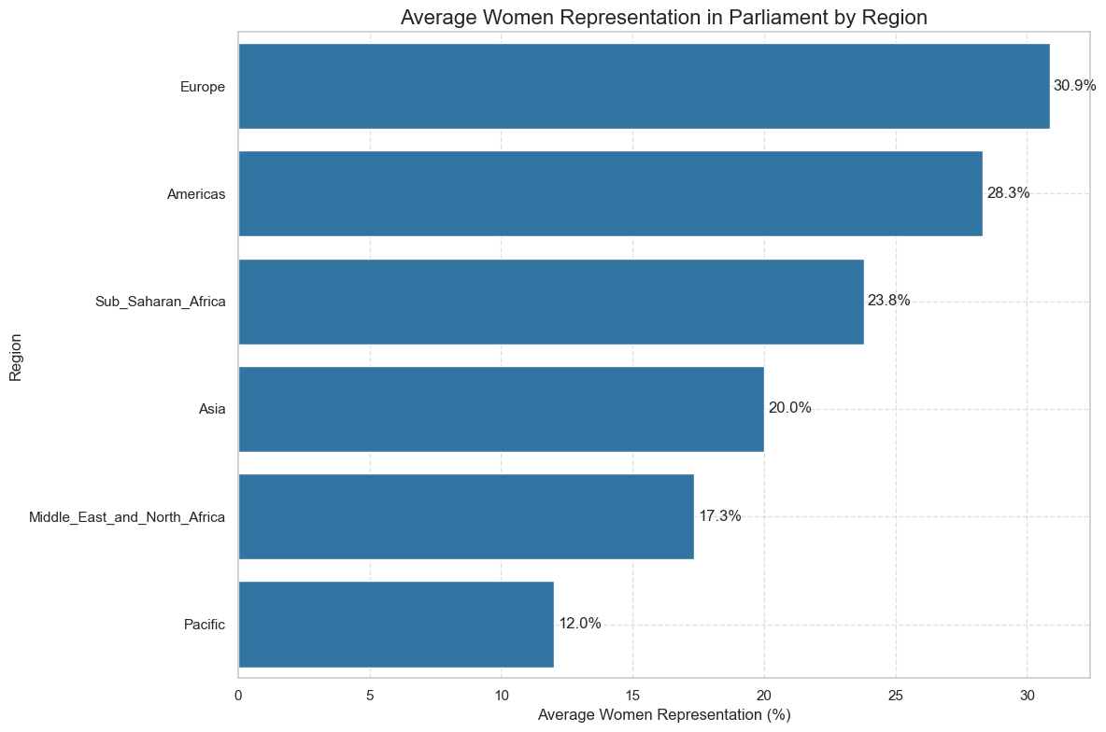
How Does Women’s Representation in Parliament Vary Across Regions(2019-2024)?

Slide 13
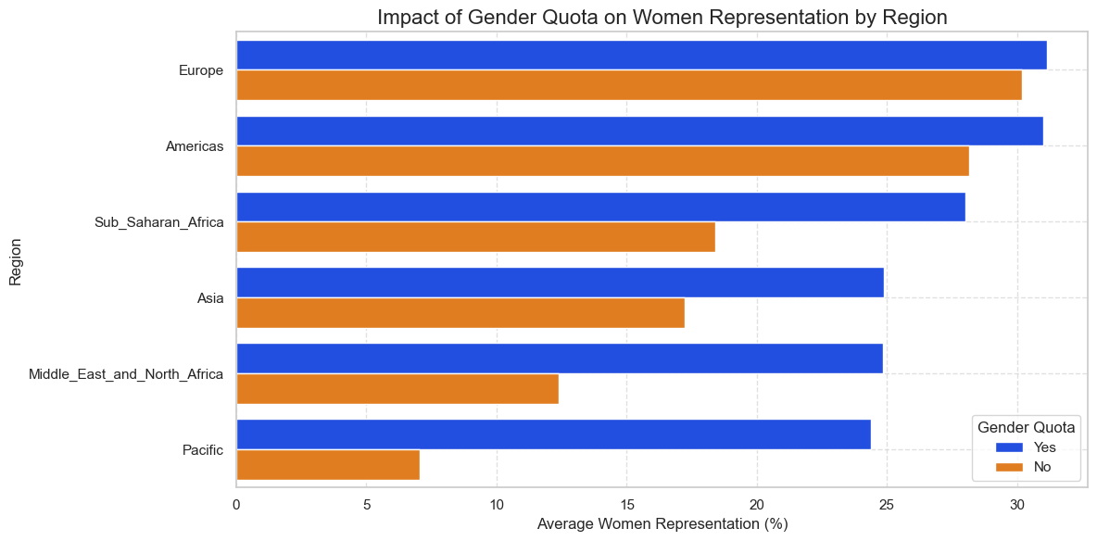
How does the presence of a gender quota impact
women's representation
in parliament across
different regions?

Slide 14
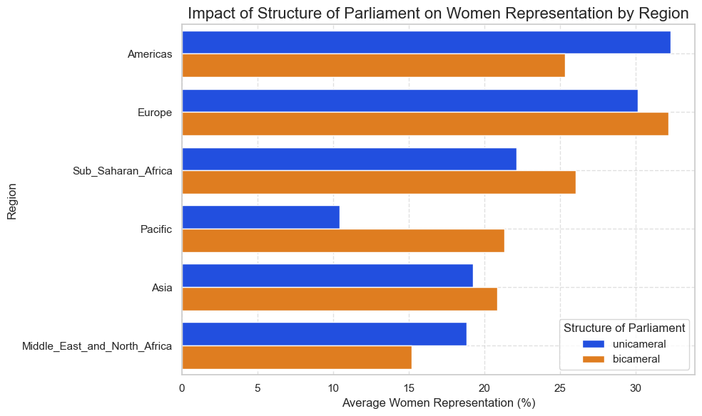
Does the structure of
parliament (unicameral vs. bicameral) impact
women's representation
in parliament across different regions?

Slide 15
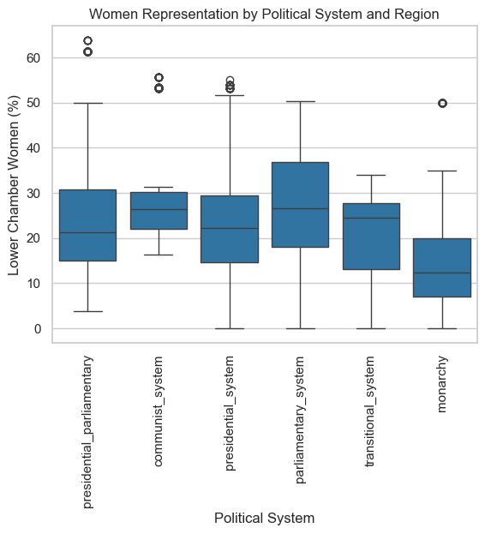
How Has the Political System Influenced Women’s Representation in Parliament
(2019-2024)?

Slide 16
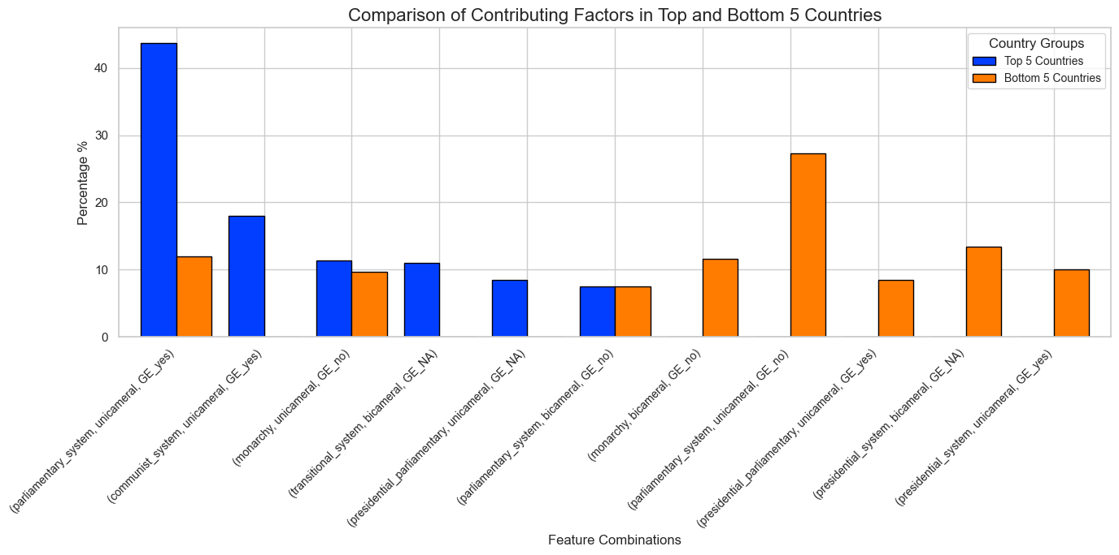
What factors most significantly
influence women's representation
in the top and bottom 5 countries?

Slide 17
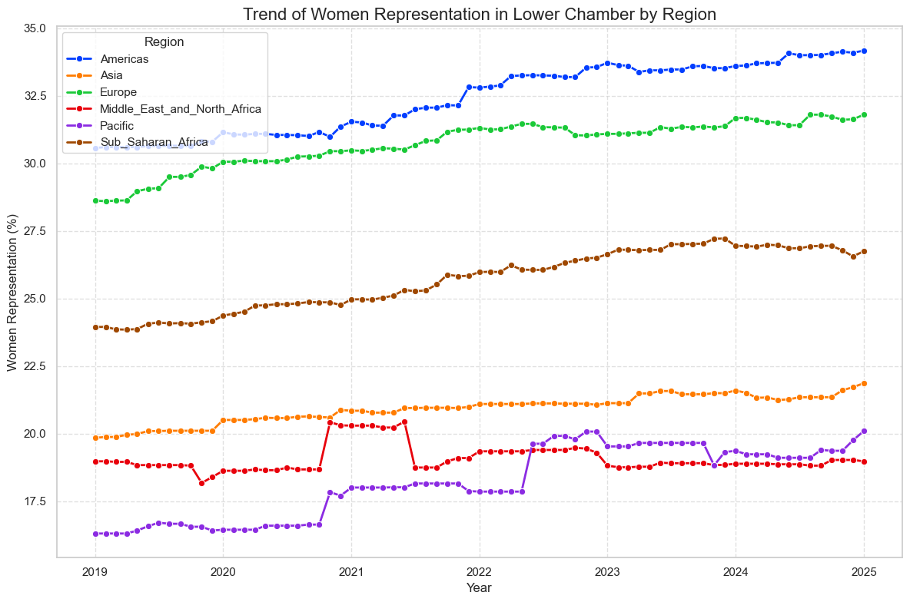
How has women's representation in the lower chamber of parliament changed over time across different regions?

Slide 18
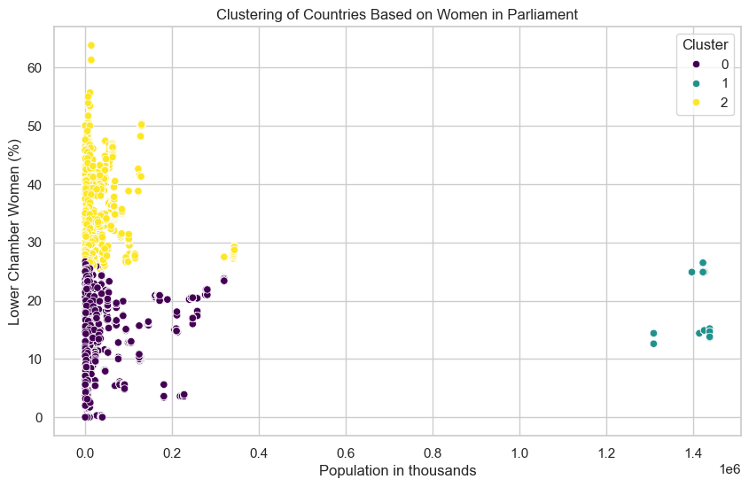
How do countries cluster based on
women's representation
in parliament and population size?

Slide 19
How do countries cluster based on women's representation in parliament and population size? (Con’t)
Cluster | Representation Level | Population Size | Characteristics | Examples
Cluster 0 | Low Representation (<30%) | Small Population (<400,000) | - Few women in parliament. - Likely due to cultural barriers and lack of gender quotas. - Limited political participation opportunities. | Tuvalu, Yemen, Oman
Cluster 1 | Moderate Representation (15-30%) | Large Population (>1 million) | - Large countries with mixed progress. - Systemic challenges in gender equality. - Political instability or weak enforcement of quotas. | India, Nigeria, Brazil
Cluster 2 | High Representation (30-60%) | Mixed Population | - Strong gender policies and quotas. - Political inclusivity and legal support. - Women hold key leadership roles. | Rwanda, Sweden, New Zealand

Slide 20
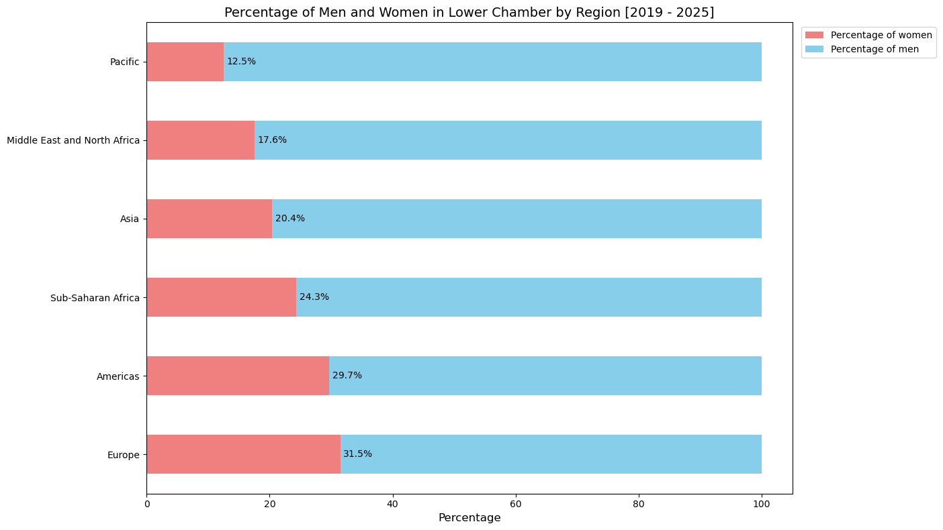
How does the gender proportion of lower chamber by region?

Slide 21
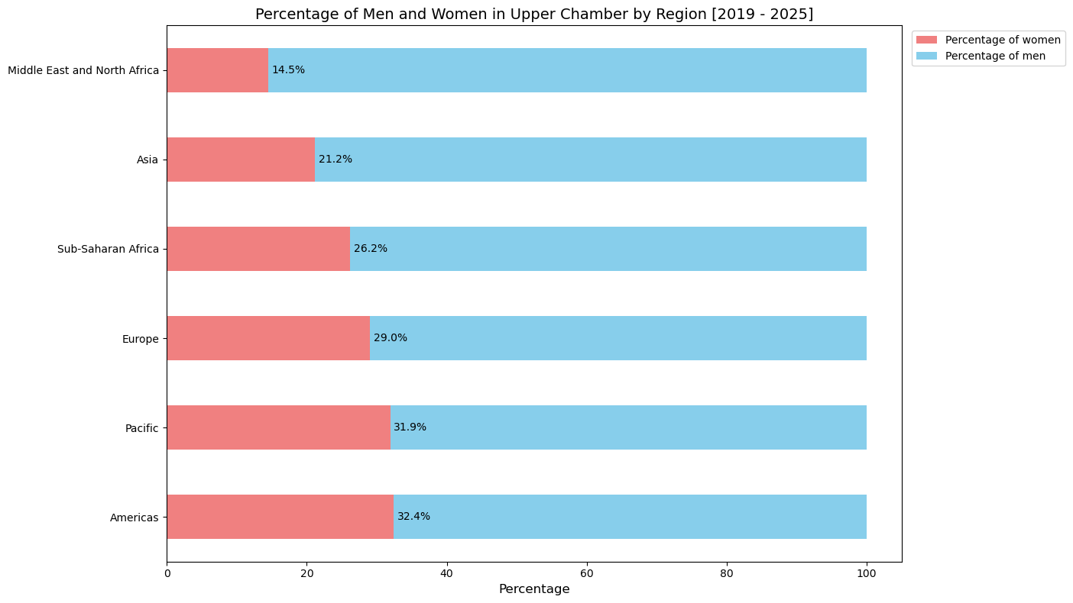
How does the gender proportion of upper chamber by region?

Slide 22
Top ten countries of Women’s Participation
in National Parliaments on Asian Region 2024

Slide 23
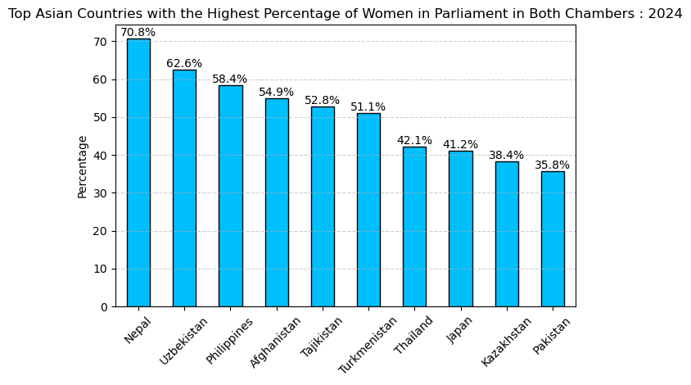

Slide 24
Countries with No Women Representatives
It has been found that no female representatives have been appointed to the lower chambers of the three countries: Yemen, Oman (Middle East and North Africa), and Tuvalu (Pacific).

Slide 25
Summary of Women's Representation in Parliament (2019-2024)
Women's representation varies across regions and is influenced by gender quotas and political structures.
Population size, total seats, and categorical factors impact women's participation.
Some countries, such as Yemen, Oman, and Tuvalu, have no female representatives in the lower chamber.

Slide 26
Political Violence Targeting Women (PVTW)
Analysis & Findings

Slide 27

Understanding the ACLED Data
Armed Conflict Location & Event Data (ACLED) is a disaggregated data collection, analysis, and crisis mapping initiative.
ACLED collects information on the dates, actors, locations, fatalities, and types of all reported political violence and protest events around the world.
ACLED acquires data and applies the political violence and protest activity include events that occur within civil wars and periods of instability, public demonstrations, and regime breakdown.
Note : ACLED data from 2019 to 2024 is utilized for this analysis.

Slide 28
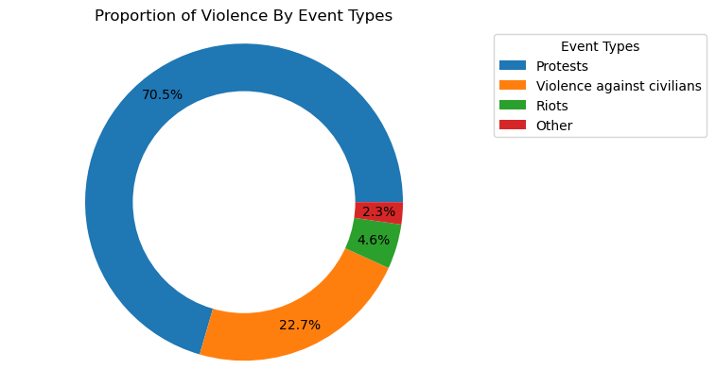
What are the most common types of PVTW events?
Notes:
💡 Key Insights:
•Most Common Event Type:
•Protest is the leading category, indicating that individuals and groups who peacefully demonstrate against a political entity, government institution, policy, group, etc.,
•Patterns of Violence:
•Violent against civilians and riots also have notable participation, indicating that women engaging in political demonstrations face significant threats.

Slide 29
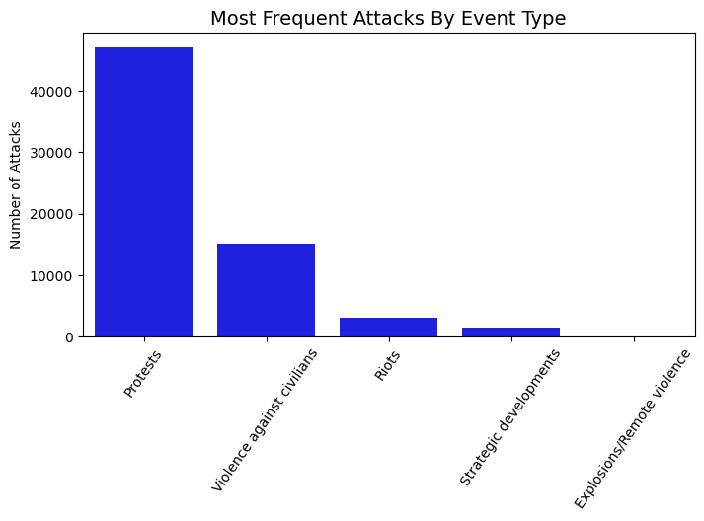
What are the most frequent attacks by event type?
Notes:
💡 Key Insights:
•Most Common Event Type:
•Protest is the leading category, indicating that individuals and groups who peacefully demonstrate against a political entity, government institution, policy, group, etc.,
•Patterns of Violence:
•Violent against civilians and riots also have notable participation, indicating that women engaging in political demonstrations face significant threats.

Slide 30
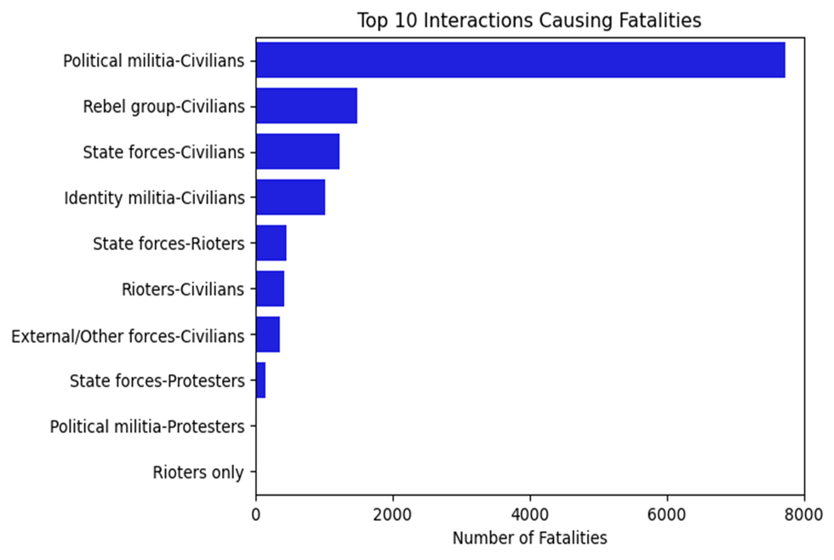
What are the most frequent interactions that cause fatalities?

Slide 31
Regional Patterns

Slide 32
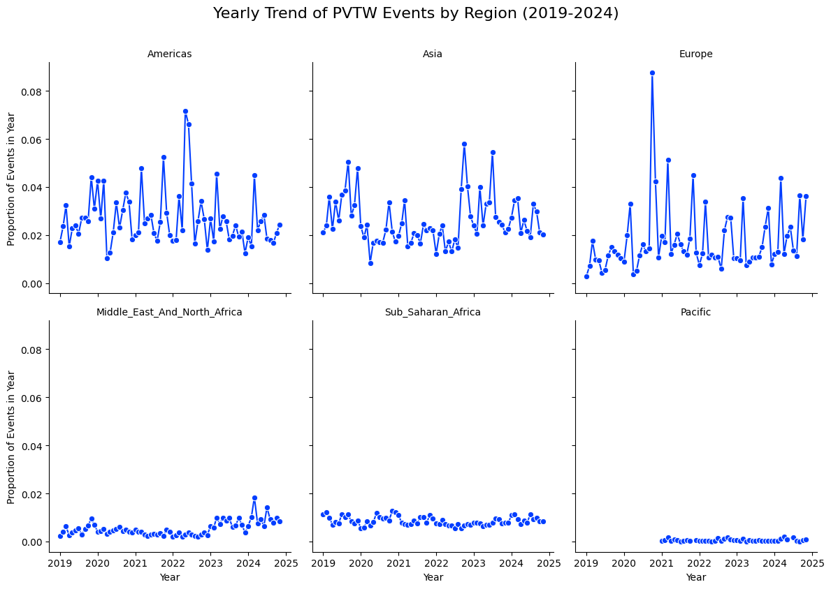
How do the proportions of PVTW events vary across different regions over time, and are there any notable spikes or trends in specific regions?

Slide 33
Regional Breakdown
Southeast Asia : Case Study

Slide 34
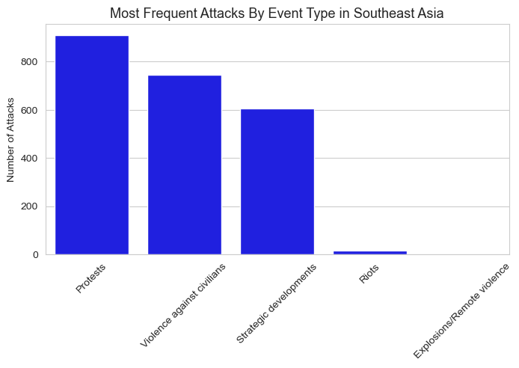
What are the most frequent attacks by event types in Southeast Asia?

Slide 35
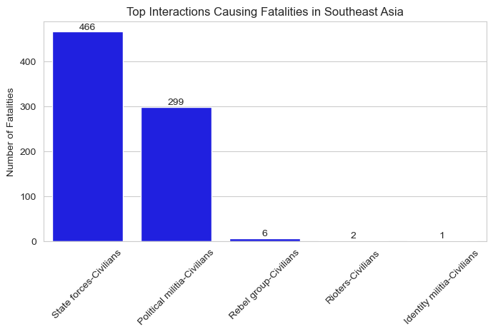
What are the most frequent interactions that cause fatalities in Southeast Asia?

Slide 36
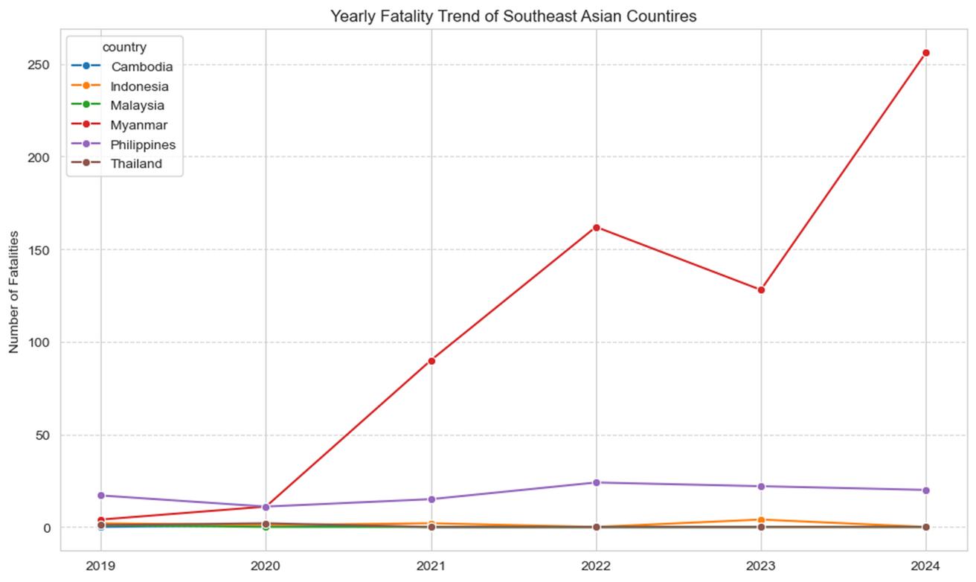
What is the yearly fatality trend in the Southeast Asian countries?

Slide 37
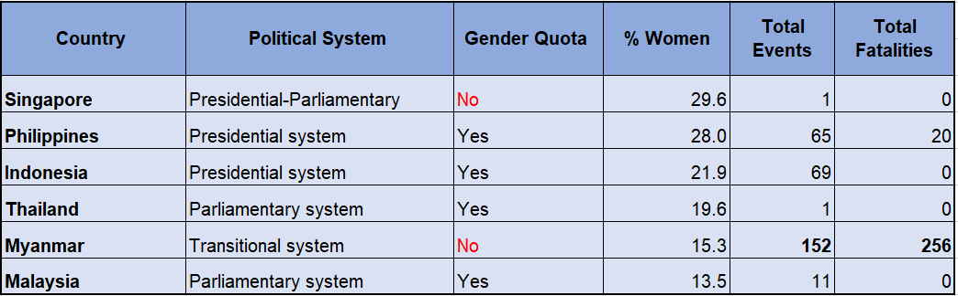
Women's involvement in Southeast Asian countries, by share of political systems, gender quotas, total events, and total fatalities, 2024
Note : The data collected by ACLED in 2024 indicate that other Southeast Asian countries, such as Cambodia, Vietnam, and East Timor, are not included in the dataset.

Slide 38
Statistical Analysis for Hypothesis Testing

Slide 39
Goal and Problem Statement
Null Hypothesis: The number of attacks and violence has no correlation with the number of women in parliament
Alternative Hypothesis: A significant relationship exists where an increase or decrease in the number of women in parliament leads to more attacks.

Slide 40
Understanding Hypothesis Testing
Null Hypothesis (H₀): Assumes no effect or no relationship
Alternative Hypothesis (H₁): Suggests an effect or relationship exists
P-Value: A number that helps us determine if our results are statistically significant. It tells us how confident we are about our results.
If p-value < 0.05, we have enough evidence to reject H₀ (suggesting a relationship exists).
If p-value ≥ 0.05, we do not have enough evidence to reject H₀.
Correlation Tests: These are tests that help us see if there’s a connection or pattern between two things. Used to measure the relationship between two variables.

Slide 41
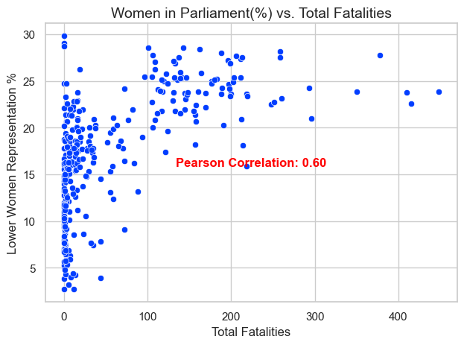
Finding Correlation Between Women in Parliament (%) and Total Fatalities
To understand this relationship more accurately, we’ll apply more advanced statistical methods.
Method Selection:
Spearman’s Rank Correlation:
Suitable for non-normal, skewed data to measure relationships.
Negative Binomial GLM:
Chosen for handling overdispersion in count data (like fatalities).
Mann-Whitney U Test:
Used for comparing two groups with skewed data.
Why Not Linear Regression?
Linear regression assumes normality, but our data is not normally distributed, so more appropriate methods are needed.

Slide 42
Statistical Test Findings
Transitional Status: A country’s parliament is in a temporary or transitional phase, awaiting the establishment of a fully functioning legislative body.
Average Women Representation (%): The monthly average percentage of women in the lower chamber of parliament. This metric helps track how women’s political representation evolves over time.
Total Fatalities: The total number of fatalities per month in incidents targeting political figures. This provides insight into the frequency and severity of political violence over time.
Test | Variable | Result | Findings
Spearman's rank correlation | Average Women Representation Vs. Total Fatalities | Correlation : 0.38, P-value: 6.142e-11 | There is a weak positive correlation between women representation and fatalities, with a very significant relationship (p-value < 0.05).
Mann-Whitney U test | Total fatalities by non-transitional period Vs Total fatalities by transitional period | Statistics 16935.5, P-value: 6.14e-11 | A significant difference in fatalities between non-transitional and transitional period, with a very low p-value indicating the difference is unlikely due to chance.

Slide 43
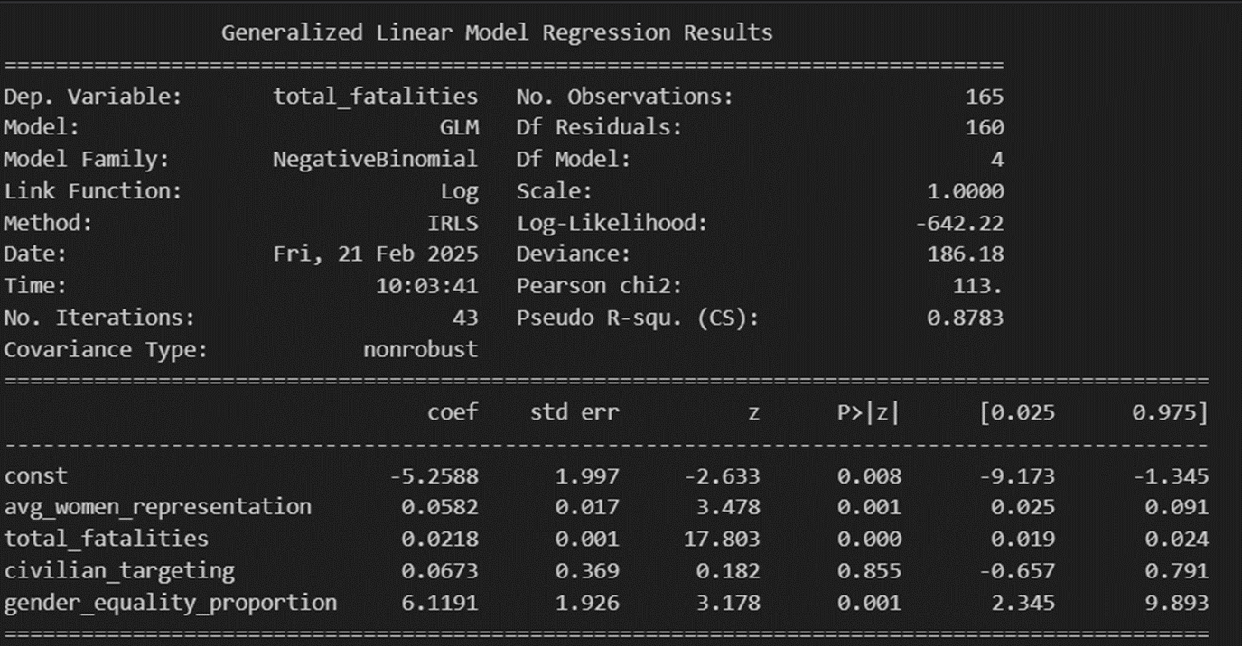
Negative Binomial Generalized Linear Model Regression Result for non-transitional period
Coefficient | Value | P-Value
Average Women Representation | 0.058 | 0.001
Total Fatalities | 0.021 | 0
Women Representation: The relationship between women representation and fatalities remains significant (coef=0.0582, p=0.001), though with a smaller effect compared to transitional period. This suggests that the relationship holds even when attacks are less frequent.
Total Fatalities: As in transitional period, fatalities show a significant effect (coef=0.0218, p=0.000), but with a lower magnitude, indicating smaller changes in fatalities compared to transitional period.

Slide 44
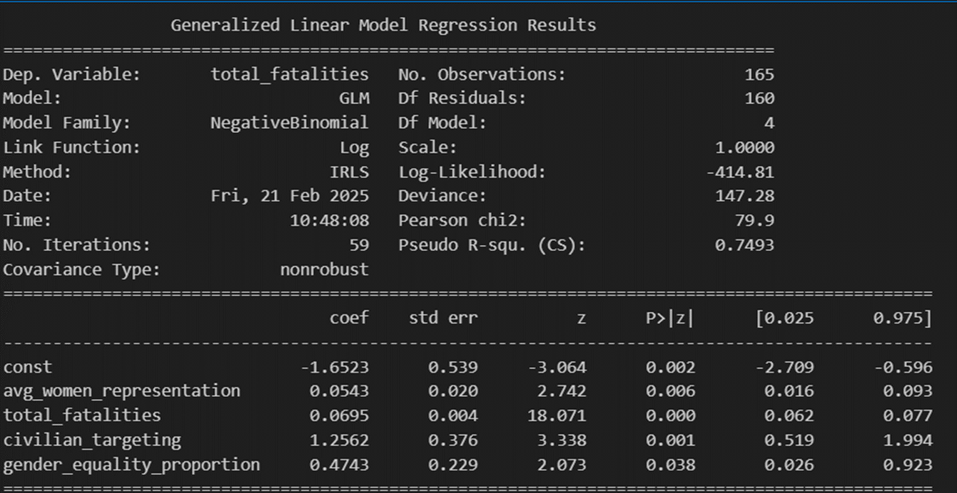
Negative Binomial Generalized Linear Model Regression Result for transitional period
Coefficient | Value | P-Value
Average Women Representation | 0.054 | 0.006
Total Fatalities | 0.0695 | 0
Women Representation: There is a positive and significant relationship between women representation in parliament and fatalities (coef=0.0543, p=0.006), suggesting that higher women representation could be linked to an increase in attacks on political figures.
Total Fatalities: The coefficient for total fatalities (coef=0.0695, p=0.000) is highly significant, indicating that an increase in fatalities is associated with greater impact from the other variables.

Slide 45
Summary & Conclusion
Based on the statistical tests, we reject the null hypothesis (H₀) and accept the alternative hypothesis (H₁). The analysis indicates that higher women’s representation is associated with an increase in political violence (PVTW events) and fatalities. However, the severity and nature of these fatalities vary depending on the country’s transitional status.
Women’s Representation & Political Violence: Higher women’s representation in parliament is correlated with an increase in political violence (PVTW events and fatalities).
The Role of Transitional Status:
Transitional countries experience higher overall fatalities, suggesting that political instability amplifies violence.
In non-transitional periods, as the system stabilizes, fatalities tend to decrease, even if women’s representation remains high.
Women’s Representation ≠ Immediate Safety: Greater political participation alone does not automatically lead to safer environments for women in politics. Instead, the interaction between political stability and societal attitudes plays a crucial role.

Slide 46
Key Takeaways & Future Research
Understanding Political Violence: Further research should investigate how factors like regional dynamics, political ideology, and media representation shape the relationship between women’s representation and political violence.
Examining the Role of Political Stability: Future studies should explore the interplay between political stability and women’s participation in politics, focusing on how political transitions and governance affect women’s safety.
Exploring Societal and Cultural Factors: Future research could delve into the role of societal attitudes, cultural norms, and institutional support systems in influencing the safety of women in politics.
Policy Recommendations: Policymakers should prioritize creating safe, supportive environments for women in politics by addressing systemic violence, strengthening legal frameworks, and promoting gender equality in political participation and legal protections and accountability mechanisms to combat political violence against women

Slide 47
Thank You for Your Attention!

Slide 48
Supplementary Slides

Slide 49
